Slide 1

“Module:
Fraud Letters & Its Types”
“Behind every suspicious review lies an investigation that protects millions of travelers.”
@ Module 1
Welcome to Fraud Support Fundamentals

Slide 2
Agenda
Fraud Letters Overview
Understand the purpose, objective, and target audience of fraud letters
Warning Letter vs. Fraud Letter
Learn about the differences between Warning Letters and Fraud Letters
Types of Fraud Letters
Familiarize yourself with different scenarios involving various types of fraud letters
Automatic Fraud Letter
Explore all the scenarios related to automatic fraud letters
Manual Fraud Letter
Master the detailed step-by-step process involved in sending manual letters
Missing or Re-sending Letters
Acquire insights into the process of boosting letters
Tripadvisor / Fraud letters
05
Notes:
A Boosting Letter is a type of Fraud Letter issued for fraudulent review manipulation. It cannot be re-sent from the Location Center and must be manually sent via the User Review Database (URD) by selecting the ID 126 Fraud Notice (Boosting). This letter helps document misconduct and enforce compliance.

Slide 3

Dubai
01. Fraud Letters - Overview

Slide 4
Fraud Letters Overview
Purpose
Operational framework for handling Warning Letters (WL) and Fraud Letters (FL) within the Fraud Support Line of Business (LOB)
Objective
Train agents to understand why these letters are generated, how they are sent, and the strict rules governing their retransmission
Target Audience
Restricted strictly to the Fraud Support team for mitigating platform risk and documenting user
non-compliance.
Tripadvisor / Fraud letters

Slide 5
Warning Letter vs. Fraud Letter
Feature Pointer | Warning Letter (WL) | Fraud Letter (FL)
Alternative Names | Suspicious Notic | Official Notification Letter
System Visibility | Shows as "Warning" in Location Center | Shows as "General" in Location Center
Severity Indicator | Yellow light / Precautionary alert | Red light / Final notice
Trigger Event | Automatically issued when the system or an agent removes 3 reviews as suspicious within a 30- day period | Confirmed Content Integrity (CI) Removal
Immediate Consequence | Formally flags account for monitoring | Location is penalized and restricted
Core Objective | Advise property of anomalous behavior | Document misconduct and enforce compliance
Frequency/Exceptions | No New Warning Letter if: Received a Fraud Letter (FL) within 90 days Received a Warning Letter (WL) within 180 days | -
Tripadvisor / Fraud letters

Slide 6

Sample Warning Letter
To the team at xxxxx
We have detected some unusual activity on your Tripadvisor listing
that has raised concerns about several reviews recently submitted for
your property. These reviews have been removed, but this action has not
led to any penalty. Our aim is to reach out proactively before
any review submissions occur that might result in penalization.
We recommend you review your own activity on Tripadvisor and speak
with your staff and vendors (especially those that might interact with your
Tripadvisor listing, like social media managers) to ensure everyone is
familiar with <a href="https://www.tripadvisorsupport.com/hc/en-us/articles/200615037 ">our guidelines</a>.
Tripadvisor Content Integrity
127SUS
Name of property: xxxxxxx
LocID: xxxxxx
Tripadvisor / Fraud letters

Slide 7
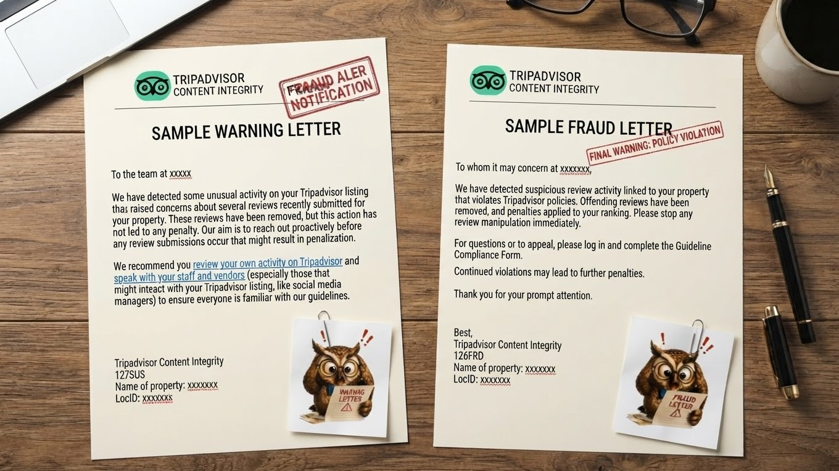

Slide 8
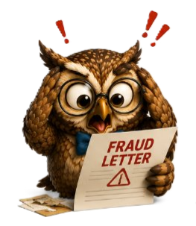
Sample Fraud Letter
To whom it may concern at xxxxxxx,
We have detected suspicious review activity linked to your property that violates Tripadvisor policies. Offending reviews have been removed, and penalties applied to your ranking. Please stop any review manipulation immediately.
For questions or to appeal, please log in and complete the Guideline Compliance Form.
Continued violations may lead to further penalties.
Thank you for your prompt attention.
Best,
Tripadvisor Content Integrity
126FRD
Name of property: xxxxxxx
LocID: xxxxxx
Tripadvisor / Fraud letters

Slide 9
Dubai
02. Types of Fraud Letters

Slide 10
Types of Fraud Letters
Automatic Fraud Letters
Manual Fraud Letters
Missing or Re-sending Letters
Manual letters are required for certain types of violations and when re-sending missing letters.
The following Fraud Letters must be sent manually via the Location Center:
Notification of Reverse Incentives
Notification of Bullying
System-generated dispatches triggered instantly by automated risk-engine protocols when specific fraud vectors are breached.
If there is no record of fraud letter in Location Notes and removed review history, treat the letter as officially missing and re-send the fraud letter or Boosting letter.
The history of Fraud Letters for a property and the most recent one can be found in the Location Center.
Tripadvisor / Fraud letters
Notes:
A Boosting Letter is a type of Fraud Letter issued for fraudulent review manipulation. It cannot be re-sent from the Location Center and must be manually sent via the User Review Database (URD) by selecting the ID 126 Fraud Notice (Boosting). This letter helps document misconduct and enforce compliance.

Slide 11
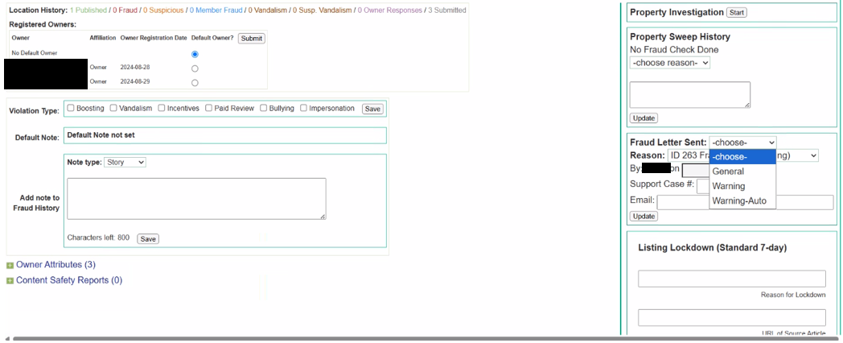
Manual Fraud Letters

Slide 12
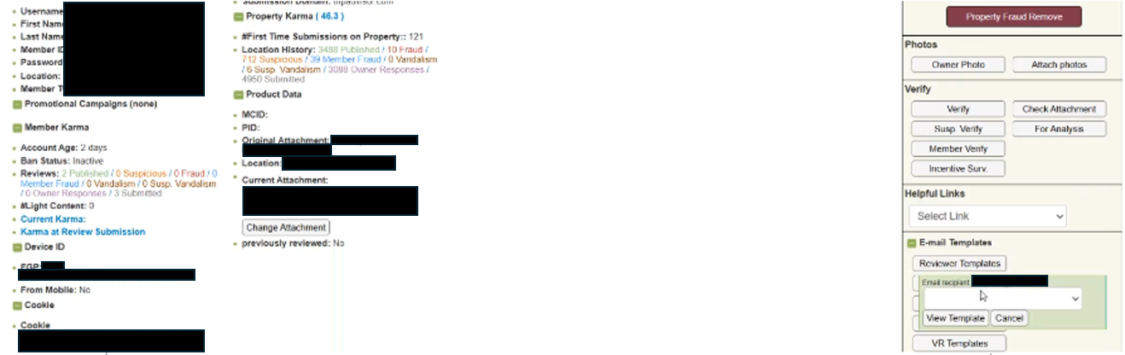
Missing or Re-sending Letters

Slide 13
Automatic Fraud Letter - Scenarios
New Violation
Same Violation Type
  The property has never received a letter
  A Notification of Fraud (FL) will be sent.
  In the last 180 days
  No new FL is sent; property is escalated for Red Badge consideration.
Same Violation Type
Different Violation Type
  more than 180 days ago
  A Notification of Fraud (FL) will be sent again.
  in the last 7 days
  No new FL is sent.
Different Violation Type
  more than 7 days ago
  A Notification of Fraud (FL) will be sent for the new violation type.
Tripadvisor / Fraud letters

Slide 14

Manual Fraud Letter – Scenarios
Reverse Incentives and Bullying letters are sent manually when the case requires reviewer intervention.
For example:
Offering free drinks in exchange for reviews may require a manual notification to be sent to the property
Procedure
Always use the most appropriate email address in the following order of priority
Most recently registered and verified owner
Email with recent owner responses
Official contact email from the property's website
or Facebook
Tripadvisor / Fraud letters

Slide 15


STEPS TO FOLLOW WHILE SENDING MANUAL LETTERS
01
02
03
04
05
06
In Location Center, select General in the Fraud Letter Sent menu
If Type, Note, Email Recipient, Reason, or Time are missing - add a Note type "Story" with the letter details
Select the Reason
Update the date field with today's date
Click Update after sending
Review the Location Notes to ensure all information is present
Note: Never use Penalty letters, as these are reserved for T2 or the Investigations Team following a Red Badge approval.
Tripadvisor / Fraud letters

Slide 16
Missing or Re-sending Letters – Procedure
General Re-send
If a Fraud Removal exists without a corresponding letter, you must re-send the fraud letter. This does not require
T2 approval.
Boosting Letters
Fraud Letters for Boosting cannot be re-sent from the Location Center. To manually send or re-send a Boosting Letter:
Go to the most recent CI-removed review in the URD
Click Fraud
Templates
Select ID 126 Fraud Notice (Boosting)
Tripadvisor / Fraud letters
Notes:
Trainer note:
Penalty Constraint: NEVER re-send a Penalty Letter. All related tickets must be handled by the Investigation team. Reviewers should not respond to the ticket before handing it to the Investigation team. Instead, add an internal note with the relevant details so the Investigations team can review the information and take appropriate action.

Slide 17


KNOWLEDGE CHECK
True or False?
A Warning Letter gives the property an immediate penalty that lowers its ranking.
TRUE
FALSE
A Warning Letter is just a friendly heads up with no penalties. A Fraud Letter is what causes immediate ranking penalties
Tripadvisor / Fraud support / Knowledge check

Slide 18
KNOWLEDGE CHECK
When sending a manual letter, which email address should you try to use first?
The contact email listed on the property's website
The most recently registered and verified owner email
The email address of the person who wrote the review
The email used for owner responses
Tripadvisor / Fraud support / Knowledge check

Slide 19
KNOWLEDGE CHECK
Where can you find the history of past Fraud Letters sent to a property?
On the public review page
On the property's social media page
In the Location Center
In the guest support inbox
Tripadvisor / Fraud support / Knowledge check

Slide 20
KNOWLEDGE CHECK
True or False?
If a property gets a Fraud Letter, it will not get a new Warning Letter for the next 90 days
TRUE
FALSE
The system automatically blocks new Warning Letters for 90 days after a Fraud Letter is sent
Tripadvisor / Fraud support / Knowledge check

Slide 21
KNOWLEDGE CHECK
What causes the system to automatically send a Warning Letter?
A customer leaves a bad 1-star review
The owner changes their business phone number
3 fake or suspicious reviews are removed within 30 days
The owner takes too long to reply to customer messages
Tripadvisor / Fraud support / Knowledge check

Slide 22
KNOWLEDGE CHECK
Which of these bad behaviors requires an agent to send a Fraud Letter manually?
Updating the property description
Bullying
Changing the profile photo
Fixing a typos in an address
Tripadvisor / Fraud support / Knowledge check

Slide 23
KNOWLEDGE CHECK
True or False?
Frontline agents can send Penalty Letters to a property whenever rules are broken.
TRUE
FALSE
Frontline agents cannot send Penalty Letters. These are strictly saved for Tier 2 or the Investigations Team
Tripadvisor / Fraud support / Knowledge check

Slide 24
KNOWLEDGE CHECK
What happens if a property breaks the exact same rule again within 180 days of receiving a Fraud Letter?
They get a new Warning Letter
No new Fraud Letter is sent, and the case is passed up for a Red Badge review
A second Fraud Letter is sent automatically
The property's listing is permanently deleted
Tripadvisor / Fraud support / Knowledge check

